Slide 1
Taxonomies in Computer Architecture: Flynn's and Feng's Classifications
Presented By: Soujanya Subedi

Slide 2
Introduction
Parallelism in computer architecture refers to the simultaneous execution of multiple tasks or instructions to improve performance and efficiency.
It enables systems to handle larger workloads, process data faster, and solve complex problems.
Parallelism Models: Flynn’s Classification and Feng's Classification

Slide 3
Flynn’s Classification

Slide 4
Flynn's Classification/ Flynn’s Taxonomy
Proposed by Michael J. Flynn in 1966.
Classifies computer systems based on how they handle instruction streams and data streams.
Instruction Streams: The sequence of instructions fetched, decoded, and executed by the processor.
Data Streams: The flow of data operated on by the instructions during execution.
Applicable in categorizing modern computing systems like AI accelerators, cloud infrastructures, and distributed systems

Slide 5
Flynn's Classification
Four Categories:
SISD: Single Instruction, Single Data
SIMD: Single Instruction, Multiple Data
MISD: Multiple Instruction, Single Data
MIMD: Multiple Instruction, Multiple Data

Slide 6
SISD (Single Instruction, Single Data)
A uniprocessor system where a single instruction operates on a single data stream at any given time.
Often referred to as sequential computers due to their step-by-step processing
Characteristics:
Only one Control Unit (CU) and one Processing Unit (PU).
Instructions are processed in a strict, sequential manner.
Primary memory stores both instructions and data.
Processing bottlenecks can occur due to the sequential nature of execution.
Notes:
Processing bottlenecks refer to points within a computer system where the rate of data processing is slowed down due to limited resources or inefficiencies

Slide 7
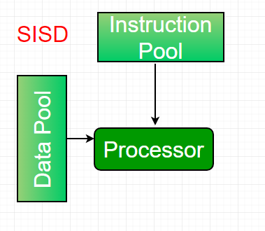

SISD (Single Instruction, Single Data)
How It Works: Fetch-Decode-Execute Cycle
Use Case: Suited for general-purpose computing, such as word processing, simple calculations, and basic operating systems.
Examples:
Von Neumann Architecture Based Computers
Intel 8085 Microprocessor
Notes:
Fetch-Decode-Execute Cycle:
The control unit fetches the instruction from memory.
Decodes the instruction.
Executes it on the specified data in memory.
Repeats the cycle for the next instruction

Slide 8
SIMD (Single Instruction, Multiple Data)
A computing system where a single instruction is executed across multiple data streams simultaneously.
Also Known as Vector Processing
Enables data-level parallelism, making it efficient for repetitive computations over large datasets
Characteristics:
One Control Unit (CU) issues a single instruction to all Processing Units (PUs) simultaneously.
Each Processing Unit works on a separate piece of data from memory.
Operations occur on a lock-step basis: all processors execute the same operation at the same time
Notes:
Data-Level Parallelism refers to a form of parallelism in which the same operation is performed on multiple data elements simultaneously.
Lock-step Basis: Processors execute simultaneously under the same control signal, ensuring synchronized parallelism.

Slide 9
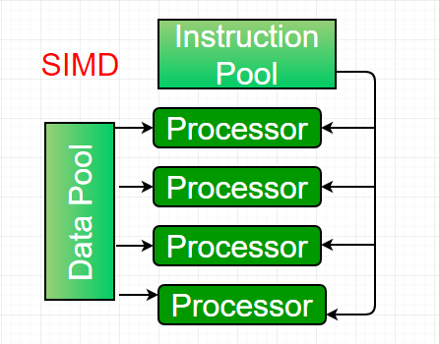
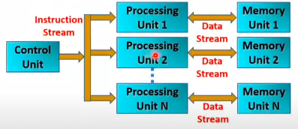
SIMD (Single Instruction, Multiple Data)
How It Works (Example):
A single instruction, such as ADD, is applied to an entire array.
If an array contains elements [1, 2, 3], SIMD can compute [1+1, 2+1, 3+1] in a single step for multiple processors.

Slide 10
SIMD (Single Instruction, Multiple Data)
Examples:
Cray Vector Processors: Early machines designed for high-performance scientific computing.
Modern GPUs (Graphics Processing Units): Specialized hardware for parallel processing in gaming, AI, and graphics rendering.
Use Cases: Scientific Simulations, Image Processing, Machine Learning

Slide 11
MISD (Multiple Instruction, Single Data)
A system where multiple instructions are executed on the same data stream simultaneously.
Represents instruction-level parallelism rather than data-level parallelism
Characteristics:
Multiple Control Units (CUs), each fetching and executing different instructions.
All instructions operate on the same input data stream.
Focuses on redundancy and fault tolerance rather than computational performance.

Slide 12
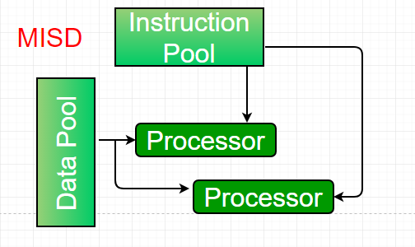
MISD (Multiple Instruction, Single Data)
How It Works (Example):
For the same input value x, different processors perform operations such as:
Processor 1: sin(x)
Processor 2: cos(x)
Processor 3: tan(x)
System can generate multiple results or validate computations for reliability.
Use Cases:
Fault Tolerance: spacecraft control or nuclear reactor monitoring.

Slide 13
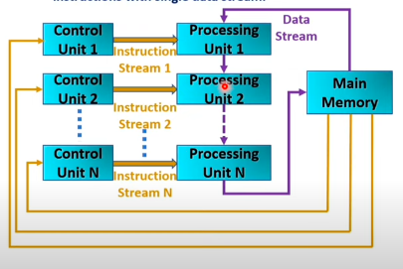
MISD (Multiple Instruction, Single Data)
Examples:
Aerospace systems for flight control and navigation, where accuracy and fault tolerance are crucial.
Specialized embedded systems in military or safety-critical industries.

Slide 14
MIMD (Multiple Instruction, Multiple Data)
A computing system where multiple processors execute different instructions on separate data streams simultaneously.
Enables task-level parallelism and asynchronous operation for diverse workloads.
Characteristics:
Each processor has its own Control Unit (CU) and Processing Unit (PU).
Instructions and data streams are independent, allowing for flexibility and high performance.
Tasks can execute in parallel without interference, making MIMD suitable for a wide range of applications.

Slide 15
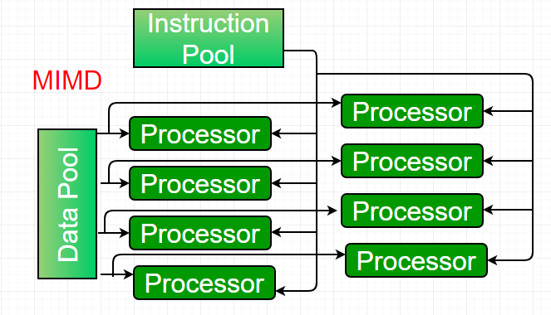
MIMD (Multiple Instruction, Multiple Data)
How It Works (Example):
Processor 1: Processes database queries.
Processor 2: Performs machine learning computations.
Processor 3: Handles user interface tasks.
Each processor operates asynchronously, optimizing resource utilization and throughput.
Two Subtypes:
Shared Memory Systems
Distributed Memory Systems

Slide 16
MIMD (Multiple Instruction, Multiple Data)
Shared Memory Systems:
Processors share access to a global memory space.
Communication occurs via shared memory, simplifying data exchange.
Examples: Symmetric Multi-Processing (SMP) systems like IBM SMP.
Distributed Memory Systems:
Each processor has its local memory, and communication happens over a network (e.g., message passing).
Scalable architecture used in clusters and grid computing.
Examples: Systems connected in mesh, tree, or hypercube networks.

Slide 17
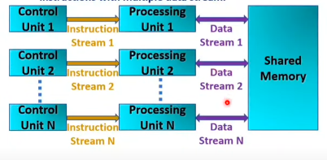
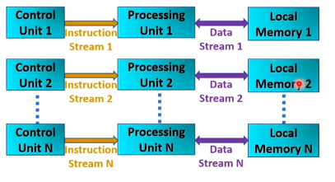
MIMD (Multiple Instruction, Multiple Data)
Shared Memory Systems
Distributed Memory Systems

Slide 18
MIMD (Multiple Instruction, Multiple Data)
Use Cases:
Multicore CPUs: Found in personal computers and mobile devices for multitasking.
Distributed Systems: Used in cloud computing and big data processing.
Supercomputers: Solve complex problems like climate modeling, genome sequencing, and AI training.
Examples:
Multicore Processors: Intel Core, AMD Ryzen.
Distributed Systems: HPC clusters, cloud data centers.
Supercomputers: Tianhe, Summit, Fugaku.

Slide 19
Feng’s Classification

Slide 20
Feng’s Classification
Proposed By Tse-Yun Feng in 1972.
Classifies computer architectures based on their degree of parallelism.
Key Concepts:
Maximum degree of parallelism P:
The maximum number of binary digits (bits) that can be processed within a unit time.
Parameters:
Let I = 1,2,3,…. T be the different timing instants and P1,P2,….PT be the corresponding bits processed
Average parallelism Pa: (P₁ + P₂ + ….. + P_{T})/T
Utilization rate μ: (Pa / P)
For full utilization: Pi=P, μ=1

Slide 21
Feng’s Classification
Four Categories
Word Serial Bit Serial (WSBS)
Word Serial Bit Parallel (WSBP)
Word Parallel Bit Serial (WPBS)
Word Parallel Bit Parallel (WPBP)
The classification is based on the content stored in memory
The contents can be data or instructions.

Slide 22
Word Serial Bit Serial (WSBS)
Bit Serial Processing: One bit of one word is processed at a time.
Slowest among all categories, due to serial operation.
Characteristics:
Single Processing Unit (PU) operates sequentially.
High processing time for complex tasks.
Example:
First-Generation Computers such as ENIAC and UNIVAC, which processed data in a strictly sequential manner.

Slide 23
Word Serial Bit Parallel (WSBP)
Word Slice Processing: All bits of one word are processed at a time, but one word at a time.
Moderate parallelism, offering improved speed over WSBS.
Characteristics:
Allows for faster computation than purely serial processing.
Suitable for tasks that can be executed word by word.
Examples:
IBM 370, Cray-1, PDP-11: These systems utilized word serial bit parallel processing to enhance efficiency.

Slide 24
Word Parallel Bit Serial (WPBS)
Bit Slice Processing: One bit from multiple words is processed simultaneously.
Moderate parallelism; emphasizes concurrency at the word level.
Characteristics:
Multiple processing units (PUs) handle different words but focus on a single bit.
Useful for operations requiring bit-level manipulation across multiple data points.
Examples:
STARAN and MPP (Massively Parallel Processors)

Slide 25
Word Parallel Bit Parallel (WPBP)
Fully Parallel Processing: All bits of all words are processed simultaneously.
Maximum parallelism; the fastest processing mode available.
Characteristics:
High throughput due to simultaneous operations across multiple processing units.
Optimal for tasks requiring extensive computation over large datasets.
Examples: C.mmp (Connection Machine Multicomputer), PEPE (Parallel Processing Engine), CRAY-2 Supercomputer, NVIDIA GPUs

Slide 26
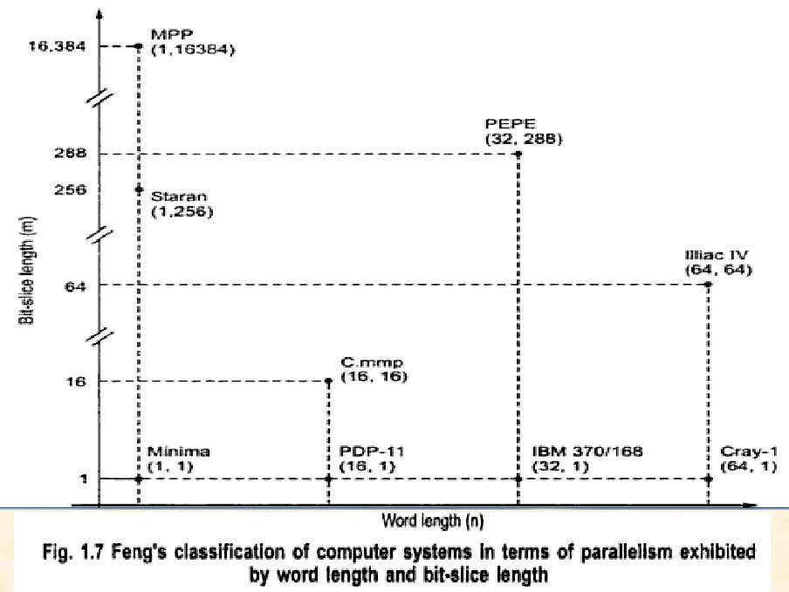
Feng's Classification

Slide 27
Flynn’s vs Feng’s Classification
Aspect | Flynn's Classification | Feng's Classification
Proposed by | Michael J. Flynn in 1966 | Tse-yun Feng in 1972
Focus | Instruction streams vs. data streams | Degree of parallelism based on bit and word processing
Parallelism Type | Focuses on instruction-level and data-level parallelism | Focuses on bit-level and word-level parallelism
Utilization Rate | Not explicitly defined | Utilization rate is defined based on the average degree of parallelism
Execution Model | Based on how instructions and data are processed | Based on the combination of serial and parallel processing at bit and word levels
Application Scope | General categories applicable to various computing systems | Focused on parallel processing architectures
Performance Effects | Higher categories (SIMD, MIMD) provide better performance for parallel tasks | Higher degrees of parallelism (WPBP) lead to maximum processing efficiency
Example Systems | SISD: Intel 8085 | WSBS: First-generation computers
 | SIMD: Modern GPUs | WSBP: IBM 370, Cray-1
 | MISD: Aerospace systems | WPBS: STARAN, MPP processors
 | MIMD: Multicore CPUs, distributed systems | WPBP: C.mmp, PEPE processors

Slide 28
The End

